Slide 1

"Connected World"
"The impact of IOT on our lives"

Slide 2
PRESENTED BY : SAP ID’s
M.AWAIS AMJAD 5112323017
M.SARMAD MUMTAZ 5112323025
OSAM ZUBAIR 5112323014

Slide 3
IOT :
The Internet of Things (IOT) is revolutionizing how we live, work, and interact with the world. This technology is creating a more interconnected world, where devices, systems, and people are increasingly linked together through the internet.

Slide 4
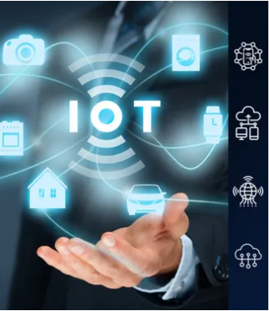
What is IOT ?
Network of Devices 2. Wide Range of
Applications
IOT involves physical devices These devices encompass
connected to the internet, everything from everyday
enabling them to collect, household items to
share, and exchange data. sophisticated industrial
machines.
3. Data and Automation
IOT devices typically include sensors, software, and other
technologies for data collection, analysis, and automated actions.

Slide 5
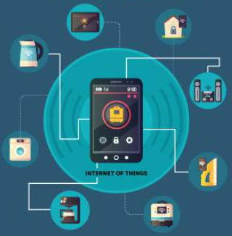
Impact of IOT: Home Automation
1. Convenience 2. Security
Control and monitor home Smart home devices can
devices from anywhere, improve security with features
enhancing comfort and easy like remote monitoring and
of use. intrusion detection.
3. Energy Efficiency
Optimizing energy consumption with smart thermostats, lighting,
and appliances.

Slide 6
Impact of IOT: Healthcare
Health Monitoring
Chronic Condition Management
IOT devices aid in managing chronic conditions by providing real-time insights and alerts to patients and caregivers.
Enhanced Care
Data gathered from IOT devices helps doctors make informed decisions, leading to better patient outcomes.
Wearable fitness trackers and remote patient monitors collect vital health data, empowering individuals and healthcare providers.

Slide 7
Connected Medical Equipment
Predictive Maintenance
2
Reduced Downtime
By identifying potential issues before they lead to failures, predictive maintenance reduces equipment downtime, ensuring that critical tools are available when needed.
3
Patient Safety
Minimizing equipment downtime enhances patient safety and improves the overall quality of care provided in hospitals.
Connecting medical equipment to IoT systems allows for real-time monitoring of equipment performance, enabling predictive maintenance.
1

Slide 8
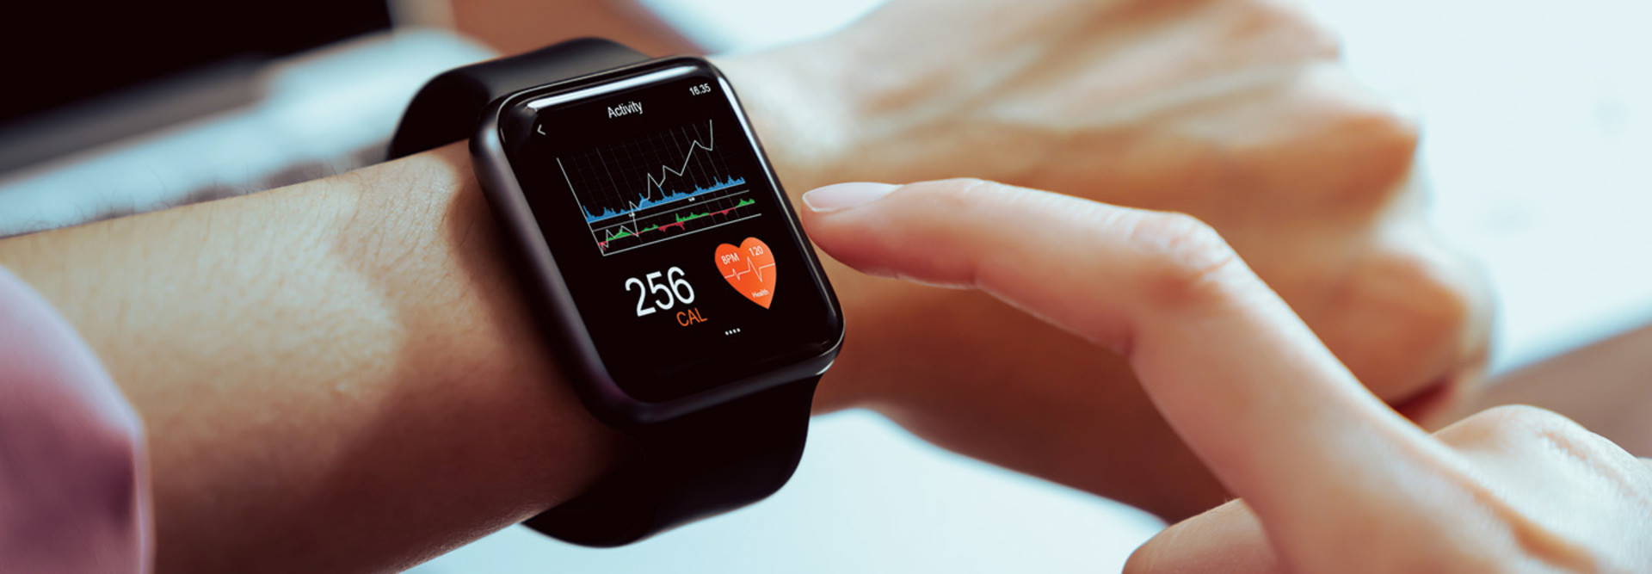
Wearable Health Devices
Activity Tracking
Personalized Insights
This data provides valuable insights into individuals' health and allows them to personalize their fitness goals and routines.
Proactive Health Management
Wearables encourage individuals to take a proactive approach to their health, leading to healthier habits and potentially reducing the risk of chronic diseases.
Wearable devices, such as fitness trackers and smartwatches, collect data on physical activity, sleep patterns, and heart rate.

Slide 9
"THE
END"

